Slide 1

RLAIF – Overview
Jiaying Liang
DS5690 Transformers Fall 2023

Slide 2
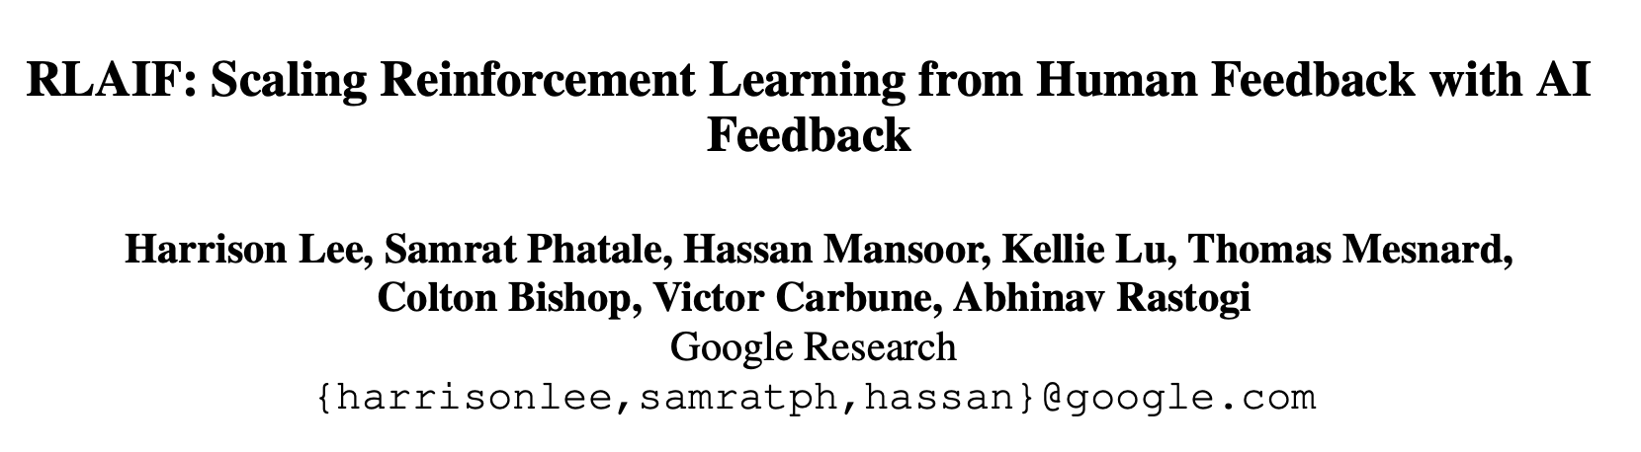
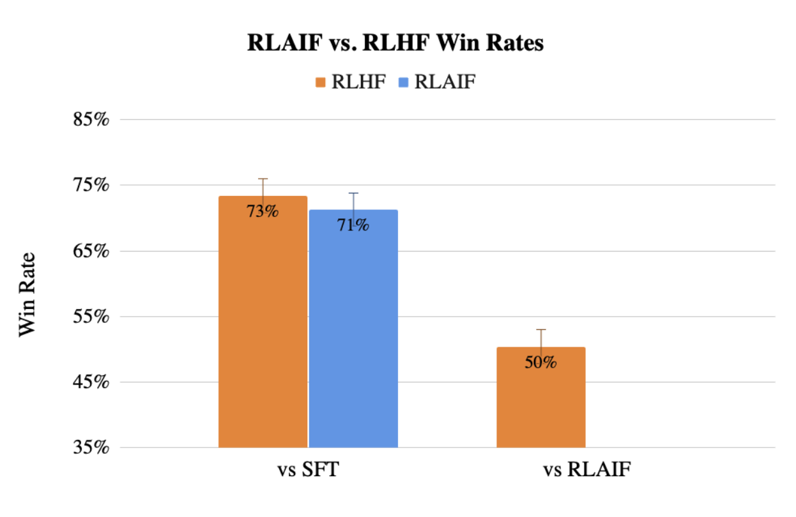
Source: https://arxiv.org/abs/2309.00267
Main Result 1:
Figure 1: Human evaluators strongly prefer RLHF and RLAIF summaries over the supervised fine-tuned (SFT) baseline. The differences in win rates between RLAIF vs. SFT and RLHF vs. SFT are not statistically significant. Additionally, when compared head-to-head, RLAIF is equally preferred to RLHF by human evaluators. Error bars denote 95% confidence intervals.

Slide 3
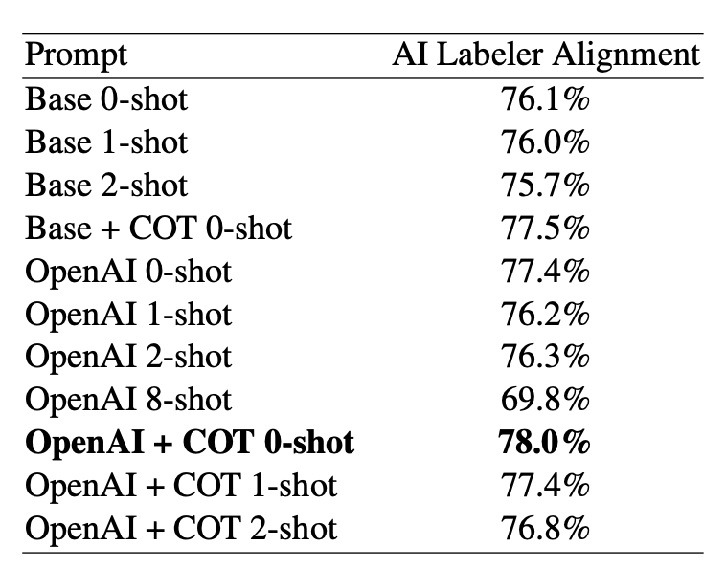
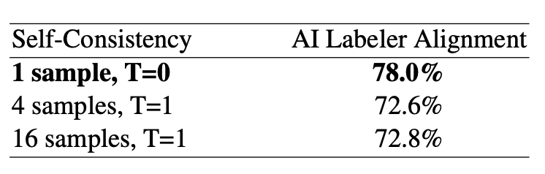
Main Result 1:
Main Result 2:
Figure 1: Human evaluators strongly prefer RLHF and RLAIF summaries over the supervised fine-tuned (SFT) baseline. The differences in win rates between RLAIF vs. SFT and RLHF vs. SFT are not statistically significant. Additionally, when compared head-to-head, RLAIF is equally preferred to RLHF by human evaluators. Error bars denote 95% confidence intervals.
Self-Consistency
Chain-of-thought: COT

Slide 4
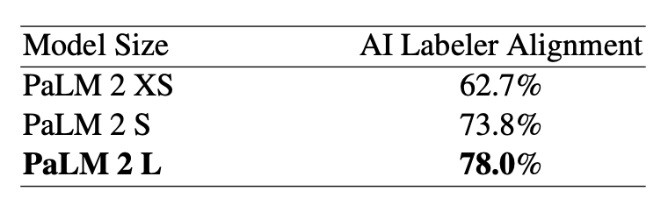
Main Result 1:
Main Result 2:
Main Result 3:
Figure 1: Human evaluators strongly prefer RLHF and RLAIF summaries over the supervised fine-tuned (SFT) baseline. The differences in win rates between RLAIF vs. SFT and RLHF vs. SFT are not statistically significant. Additionally, when compared head-to-head, RLAIF is equally preferred to RLHF by human evaluators. Error bars denote 95% confidence intervals.
Table 4: AI Labeler Alignment increases as the size of the LLM labeler increases.
Self-Consistency
Chain-of-thought: COT

Slide 5
Main Result 1:
Main Result 2:
Main Result 3:
Figure 1: Human evaluators strongly prefer RLHF and RLAIF summaries over the supervised fine-tuned (SFT) baseline. The differences in win rates between RLAIF vs. SFT and RLHF vs. SFT are not statistically significant. Additionally, when compared head-to-head, RLAIF is equally preferred to RLHF by human evaluators. Error bars denote 95% confidence intervals.
Table 4: AI Labeler Alignment increases as the size of the LLM labeler increases.
Self-Consistency
Chain-of-thought: COT

Slide 6
Thank you!
Contact info: jiaying.liang@vanderbilt.edu

Slide 7
References
Lee, H., Phatale, S., Mansoor, H., Lu, K., Mesnard, T., Bishop, C., ... & Rastogi, A. (2023). Rlaif: Scaling reinforcement learning from human feedback with ai feedback. arXiv preprint arXiv:2309.00267.

